Slide 1
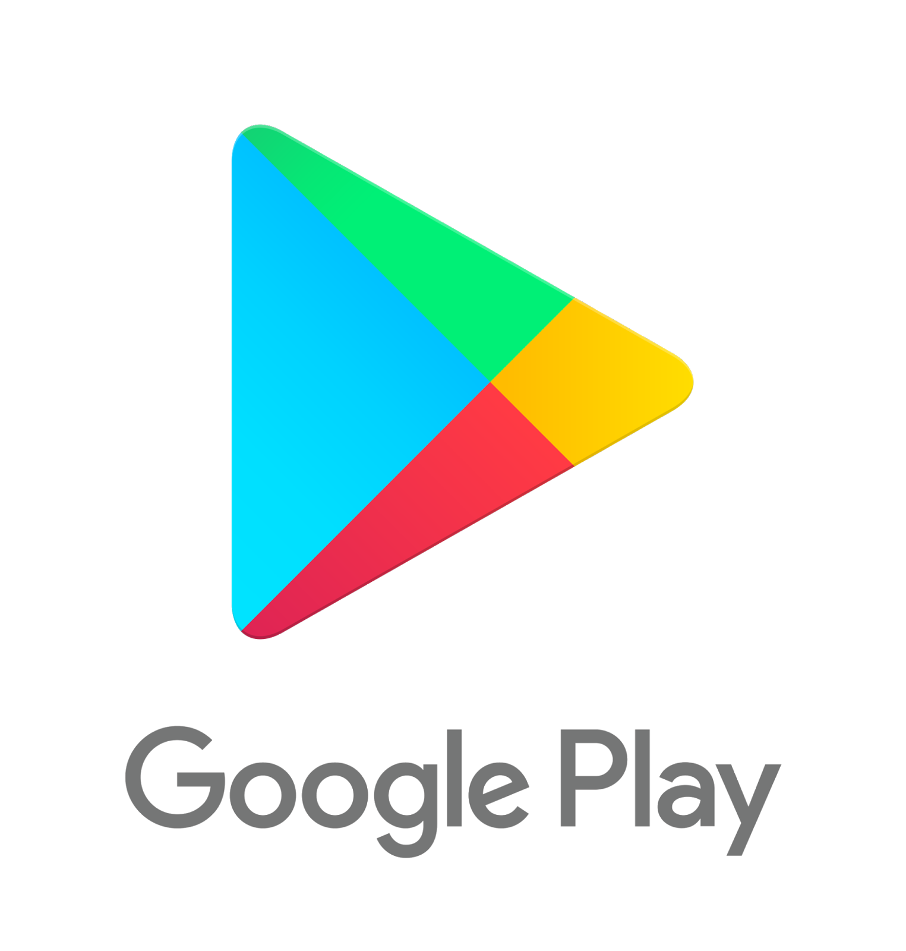
Analysis of Google Play Store Apps
Bibek Shrees

Slide 2
Table of Contents
Introduction to Data set
Goals of analysis
Analysis and Visualization
Results of analysis
Conclusion

Slide 3
Introduction
Includes dataset of over 10,000 apps on google play store
I chose this dataset because I was curious to know the overview of the apps in google store.
Reference: https://www.kaggle.com/lava18/google-play-store-apps

Slide 4
Data set -10,842 Total app entries - 9,367 Unique app entries
Columns in the dataset about the apps
App: Name of the app
Category: Category the app belongs
Rating: Rating of the app from 1 to 5
Reviews: The number of reviews the app has
Size: Size of the app
Installs: Number of times apps has been installed
Type: Whether the app is paid or free
Price : Price of the app
Content Rating: Who the app is targeted towards- Everyone, Children, Adult
Genres: Genre of the app
Last Updated: When the app was updated at the play store
Current Ver: The version of the apps that is available in the play store
Android Ver: Minimum android version needed to install the app

Slide 5
Questions
Which App Category has the maximum no of reviews and what are the top 10 Dating apps by reviews and Rating?
How is the Rating distributed in the Play Store?
When is the apps last updated?

Slide 6
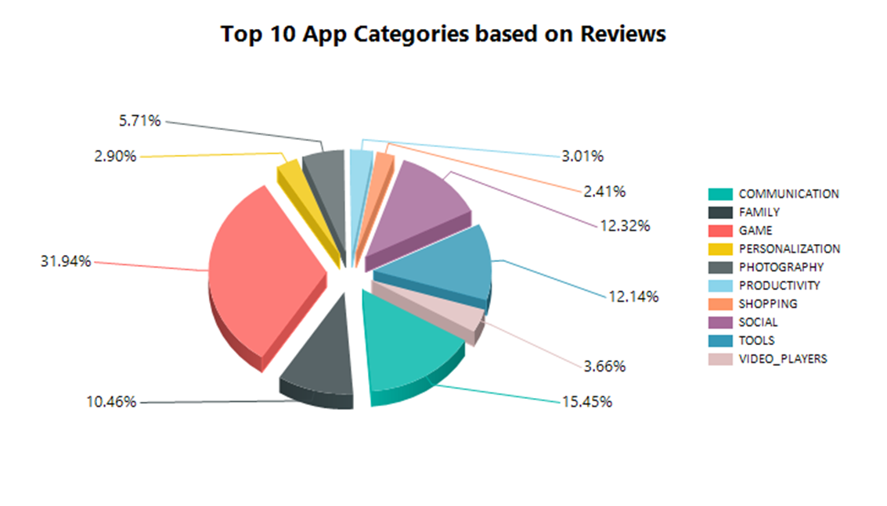
Data analysis for Question 1 ( Report Builder)

Slide 7
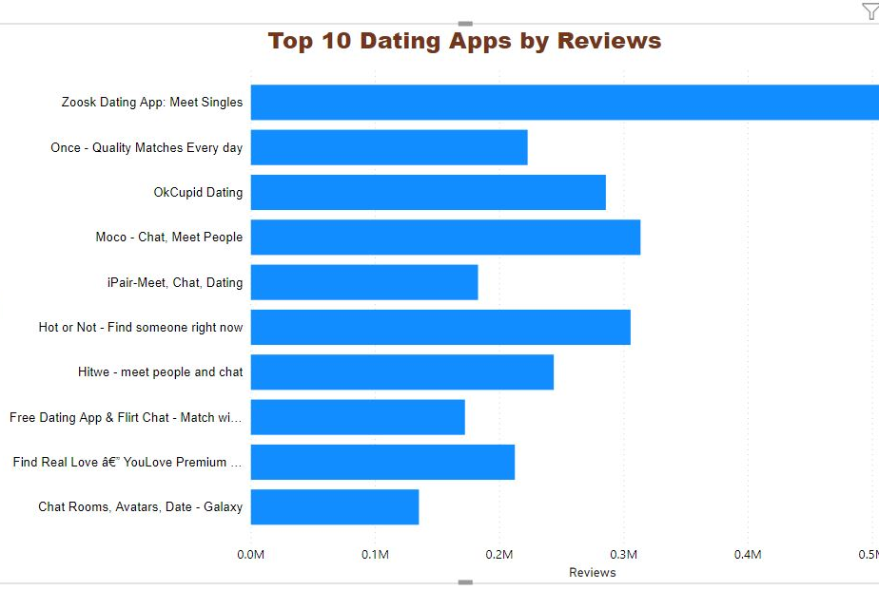
Dating Apps (Power BI)

Slide 8
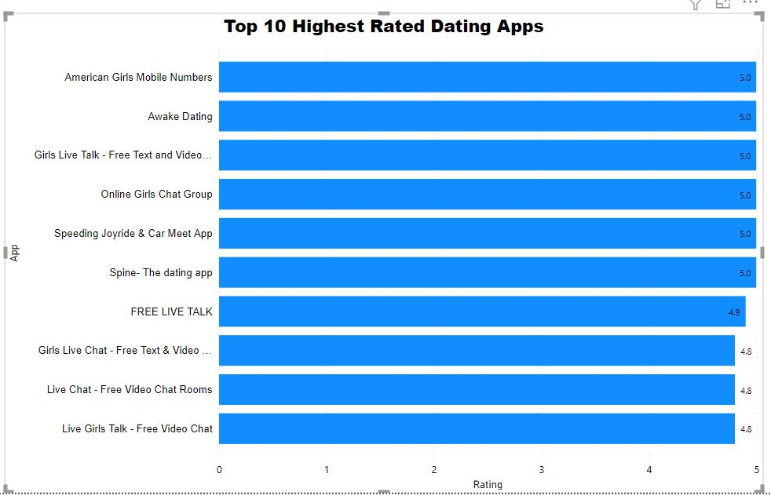
Dating Apps (Power BI)

Slide 9
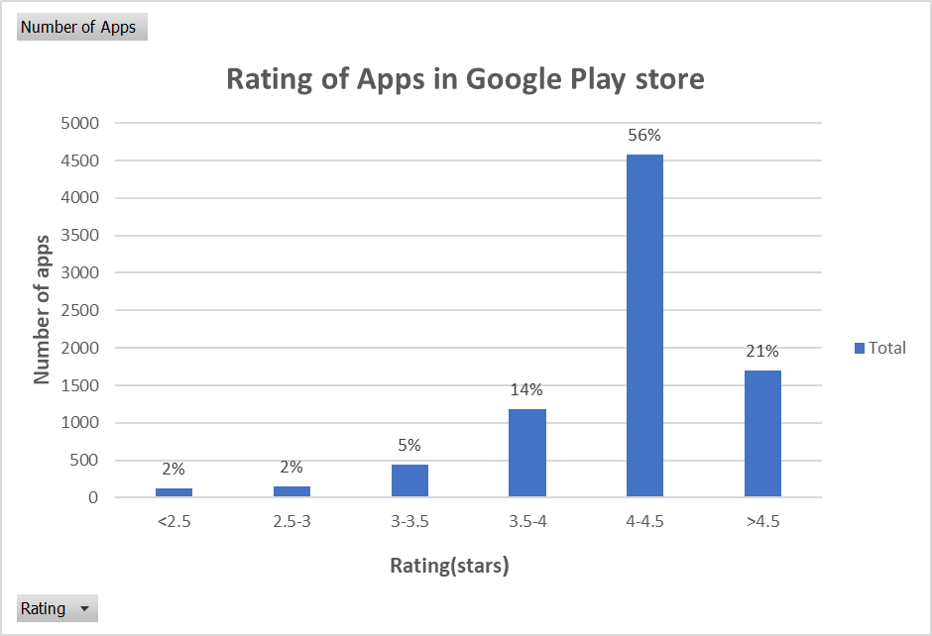
Data Analysis For Question 2 (Excel)

Slide 10
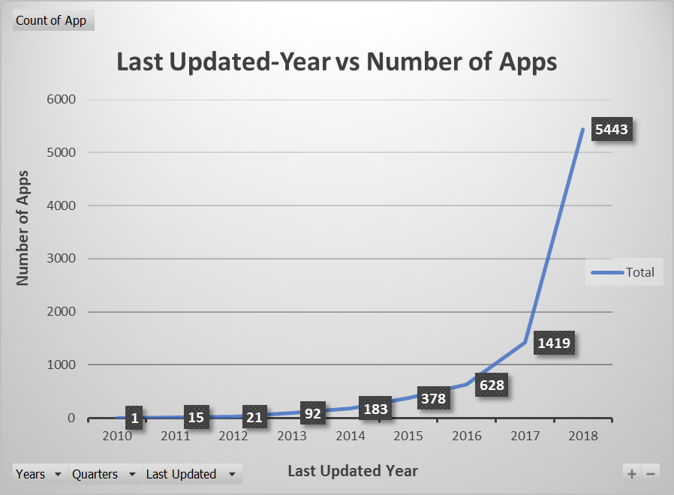
Data Analysis for Question 3 (Excel)

Slide 11
Data Analysis Results
Game category has highest reviews and Zoosk Dating App has the maximum number of reviews in Dating Category.
Most of the apps has rating between 4 to 4.5.
Most of the apps were updated in 2018.

Slide 12
Conclusion
This analysis can help to get insightful about the apps used by android users.
It can help the android developers to understand the overview of the apps on the Play store.

Slide 13
Thank You

